Slide 1
UNIT 5: TECHNICAL SUPPORT
Agenda: Technical support vocabulary and expressions – Indirect questions – Relative clauses –Technical support procedure
English for Information Technology 6

Slide 2

Objectives
At the end of this unit,
you will be able to:
Make a telephone conversation or face-to-face conversation to support a customer
Talk about the procedure for handling a customer’s inquiry, request or complaint

Slide 3
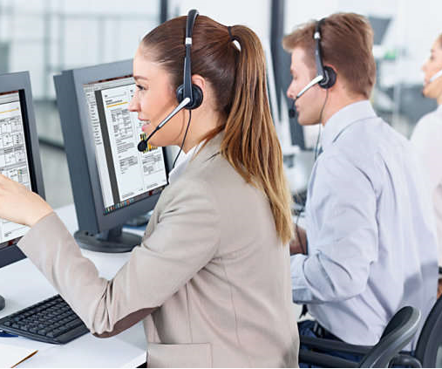
Lesson 1
Customer support conversations:
Telephone
Face-to-face

Slide 4
Warm-up: BINGO GAME
Work in two groups
Say ‘Bingo’ to give answers to the questions
+10 points for each correct answer
-5 points for wrong answer
The team with higher points will be the winner

Slide 5
1. Fill in the gaps with suitable word
You should show e_ _ _ _ _ _ when handling a customer’s complaint by saying things like “I would be upset too if I were you”.
empathy

Slide 6
2. Choose the best answer.
A(n) ________ response from a real person has a much better calming effect on an angry customer than an automated voice message.
dedicated
truthful
empathetic
authentic

Slide 7
3. What belongs to you but yet is used more by others than yourself?
Key: Your name

Slide 8
4. Fill in the gaps with suitable word
Only close the ticket after you get c_ _ _ _ _ _ _ _ _ _ _ from the customer that the problem has been resolved to his or her satisfaction.
confirmation

Slide 9
5. Fill in the gaps with suitable word
All IT companies should have a robust p_ _ _ _ _ _ _ _ for handling customer’s complaint.
procedure

Slide 10
6. Choose the best answer.
I’m light as a feather, yet the strongest man can’t hold me for more than 5 minutes. What am I?
A ton of bricks
A policy
A sexy woman
A breath

Slide 11
7. Fill in the gaps with suitable word
Maximizing customer’s s_ _ _ _ _ _ _ _ _ _ _ is the ultimate goal of any service organization.
satisfaction

Slide 12
8. Choose the best answer.
I don’t think that helpdesk technician is ________at all. He kept interrupting me when tried to explain my problem.
empathetic
satisfying
professional
dedicated

Slide 13
9. What occurs twice in a week, once in a year, but never in a day?
Key: the letter E

Slide 14
10. Fill in the gaps with suitable word
We purchased some b_ _ _ _ h_ _ _ _ from an Indian outsourcing company and we ask them for support whenever we need.
block hours

Slide 15
11. I am what I am, but if you know what I am, then I’m no longer what I am. What am I?
Key: a secret

Slide 16
12. Choose the best answer.
Milestone promises to provide a ______ of any computer-related incidents within 48 hours.
resolution
complexity
Infrastructure
vulnerability

Slide 17
13. Choose the best answer.
I think we should consider _______ some of our IT operations because our operations are getting too complex for the IT department to handle alone.
utilizing
supporting
monitoring
outsourcing

Slide 18
14. Choose the best answer.
I’m full of keys, but I can’t open any doors. What am I?
A notebook
A piano
A computer
A box

Slide 19
15. What can be broken even without a touch?
Key: a promise/ silence

Slide 20
Activity 1: Classifying sentences
Work in pairs
Put the sentences in the correct categories by writing a letter in the provided boxes
R: making requests C: making complaints I: making inquiries | U: asking for update on an issue G: asking for guidance/instruction E: asking for explanations

Slide 21
1. Can you give me some information about the newly-released software extension? | □
2. There has been an issue with your photo editing software, it keeps crashing. | □
3. I’d like some pointers on how to install the necessary drivers for my printer | □
4. I’m calling for an update about my connection problem. | □
5. Could you explain to me how my log in attempts failed? | □
6. I want to know when you’re going to release the next update? | □
7. I’m calling to report an issue I have had recently with your antivirus program. | □
8. Can you walk me through the steps to turn on the auto update feature? | □
9. Would it be possible for you to reschedule the technician’s visit to my company? | □
10. Can you tell me how my saved data got lost? | □
11. I called you last week about my network issue. I’d like to know what has been done about it. | □
12. Can you send me the information about your latest update to my email? | □
I
C
G
U
E
I
C
G
R
E
U
R

Slide 22

Activity 2: Making sentences
Work in pairs
Make complete sentences based on the suggestions

Slide 23

a. | I/glad/inform/you/connection issue/resolved. We/send/you/letter of resolution/shortly. | □
⇨ | ……………………………………………………………………………………………………..
b. | Next update/available/next month. We/call/you/as soon as/it/released. | □
⇨ | ……………………………………………………………………………………………………..
c. | I/sorry/hear/that. Can you tell/me/version/program/you/currently/use? | □
⇨ | ……………………………………………………………………………………………………..
d. | First/you/need/download/drivers/our website. After/download/complete/click/icon/open/it. | □
⇨ | ……………………………………………………………………………………………………..
e. | I/sure/that/not/problem. What time/be/convenient/you? | □
⇨ | ……………………………………………………………………………………………………..
f. | I/apologize/inconvenience/you have. Could/you/give/details? | □
⇨ | ……………………………………………………………………………………………………..
4
I am glad to inform you the connection issue has been resolved. We will send you a letter of resolution shortly.
6
The next update will be available next month. We will call you as soon as it is released.
2
I am sorry to hear that. Can you tell me which version of the program you are currently using?
3
First you need to download the drivers from our website.
After the download is complete, click on the icon to open it.
9
I’m sure that’s not a problem. What time would be convenient for you?
7
I apologize for any inconveniences you have had. Could you give me more details please?

Slide 24
g. | Certainly/please check/email/5 minutes. | □
⇨ | ……………………………………………………………………………………………………..
h. | I/assure/you/technicians/working hard/resolve it. We/get back/you/soon. | □
⇨ | ……………………………………………………………………………………………………..
i. | Sure/it/very simple. Click/ “Option” tab/check/ “automatic update” box. | □
⇨ | ……………………………………………………………………………………………………..
j. | There/be/problem/your browser/that/prevent/you/access/your account. | □
⇨ | ……………………………………………………………………………………………………..
k. | Of course. 2.0 extension/released/Windows 10. It/have/new/exciting/features. | □
⇨ | ……………………………………………………………………………………………………..
l. | Well/virus/which/infect/system/damaging/your stored data. | □
⇨ | ……………………………………………………………………………………………………..
12
Certainly, please check your email in 5 minutes.
11
I assure you that our technicians are working very hard to resolve it. We will get back to you soon.
8
Sure, it is very simple. Click on the “Option” tab then check the “automatic update” box.
5
There was a problem with your browser that prevented you from accessing your account.
1
Of course. The 2.0 extension has been released for Windows 10. It has many new exciting features.
10
Well, a virus which infected your system is damaging your stored data.

Slide 25
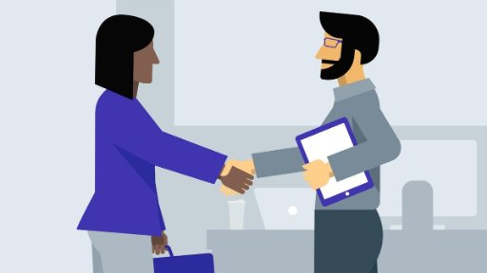
Activity 3: Role-play
- Work in pairs, student A plays the role of a customer and student B plays the role of a technician
- Make a conversation between a customer and a technician in common support situations

Slide 26
- Greet the customer
- Identify yourself
- Good morning/afternoon…
- This is …, service agent/support technician of … company
-Complain about a problem with…
Say you have a problem…
I’m afraid I have a complaint about…
- I’m calling because there has been/ I’m having a problem with …
- Ask for … name and phone number
- Let me just get your name and phone number in case we get disconnected.
- Could I have your name and phone number, please?

Slide 27
Ask for details of problem
Ask for more details
What kind of problem do you have?
Can you be more specific, please?
What exactly is the problem?
Can you give me more details, please?
-Summarize the details
First, let me summarize the details: your name is…/Now let me repeat back to you to check if I got everything down correctly. Your name is…
Ask … for confirmation
Ask … if you have the correct information
- Is that correct?

Slide 28
Confirm the details
That sounds about right.
Yes, that’s right.
Apologize
Empathize
Reassure
I’m sorry this has happened to you.
I’m sure I’d be upset too if I were you.
I’m going to do all that I can to help you.
Ask for + Noun
Ask B to V(bare) …
Ask if S …
Say (that) you + V+ …
Can you tell me + Noun
Can/Could you + V (bare) …
Do + S + V(bare) + …
I + V+…
Offer additional help
Is there anything I can help you with?

Slide 29
Conversation 1: Asking for information
A: Technician | B: Customer
- Greet the customer - Identify yourself | Greet the technician - Identify yourself - Ask for information about Half-life: Alyx
Ask B what he/she wants to know | Ask for release date
Respond: March 2020 (on Windows) | Ask A if you need special hardware
Respond: PC-compatible VR headset | Ask A about system requirements
State minimum requirements: Processor: Core i5-7500 , Ram: 12 GB, Graphic card: Nvidia GTX 1060 | Thank A
- Offers additional help | Decline.
- End the conversation | Say goodbye

Slide 30
Conversation 1
A: Hello, customer support, how may I help you?
B: Yes, I’d like some information about the game Half-life: Alyx.
A: Of course, what would you like to know?
B: First of all, when was it released?
A: It was released on Windows in March 2020.
B: Do I need any special hardware to play this game?
A: I’m afraid you do. You need a PC-compatible VR headset like a Valve Index or Oculus Rift.
B: I see. Can you tell me about system requirements I need to play it?
A: Well as for processor and memory, you will need at least Core i5-7500 and 12GB of RAM. As for graphic card, you need an Nvidia GTX 1060.
B: Thanks for your information.
A: Glad to be of help.

Slide 31
Conversation 2: Asking for instruction
A: Customer
1. Ask to speak to tech support
2. Say you have a problem with Excel spreadsheet
3. Explain: the first row always shows up when printing a table that is several pages long
⇨ ask for instructions to remove it.
4. State your name and phone number
5. Follow each step of the instruction
6. Confirm that you have resolved the issue and thank the technician.
B: Technician
1. Greet the customer and Identify yourself
2. Ask for more details
3. Ask for A’s name and phone number
4. Provide the instruction step by step: click “Page layout” tab ⇨ click “print titles” option ⇨ dialogue box will open ⇨ select “sheet” tab (last one on the right) ⇨ clear “rows to repeat at top” box.
5. Asking for confirmation that the customer can resolve the issue
6. Offer additional help and end the conversation

Slide 32
Conversation 2
A: Hello, is this the customer support?
A: Yes, this is Peter, support technician. How can I help?
B: Well, I’m calling because I’m having a problem with the Excel spreadsheet.
A: Can you be more specific, please?/ What exactly is the problem?
B: Well, the first row always shows up when I print a table that is several pages long. So what should I do to remove it?/ Is it possible to remove it?
A: That’s very easy. But can I have your name and your phone number, please?
B: I’m John Walker. My phone number is 09… Can you walk me through the steps?
A: First, you need to click on the “Page layout” tab.
B: OK, done. What’s next?

Slide 33
Conversation 2 (continued)
A: Right, you need to access the “print titles” option. Click on that and a dialogue box will show up. Are you following me?
B: Um, OK. I see that now.
A: Good, now click on “sheet” tab. It is the last one on the right.
B: OK I see.
A: Now delete everything in the “rows to repeat at top” box.
B: Oh, I can do that. Thanks for your help.
A: Is there anything I can hẹp you with?
B: No, thanks again.
A: You’re welcome. Don’t hesitate to call us if you have any more questions.

Slide 34
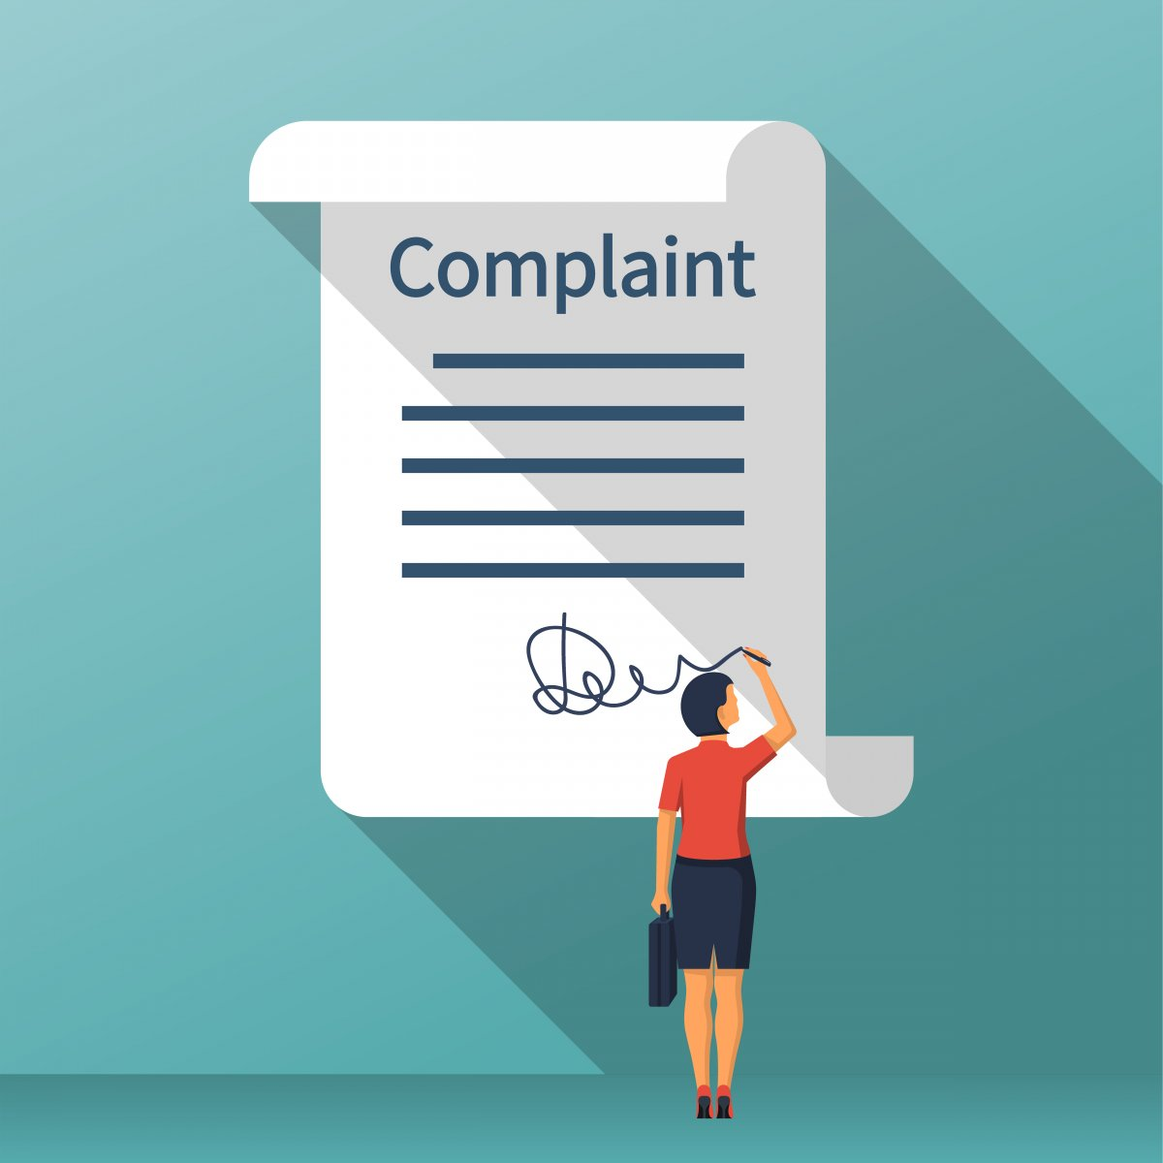
Lesson 2
Handling a customer’s complaint
Conversation
Procedure

Slide 35

Warm-up: Rows and columns
- Work individually
- Stand in rows and columns
- Answer the teacher’s question. If you can answer correctly within 3 seconds, sit down and ask 2 friends in the same column OR row to sit down with you. If you can’t, everyone in the same row AND column must stand up.

Slide 36

Activity 4: Completing the flowchart
- Work in groups of 4-5 to complete the flow chart
- Use Grammar presentation 4 at the beginning of the unit to help you

Slide 37
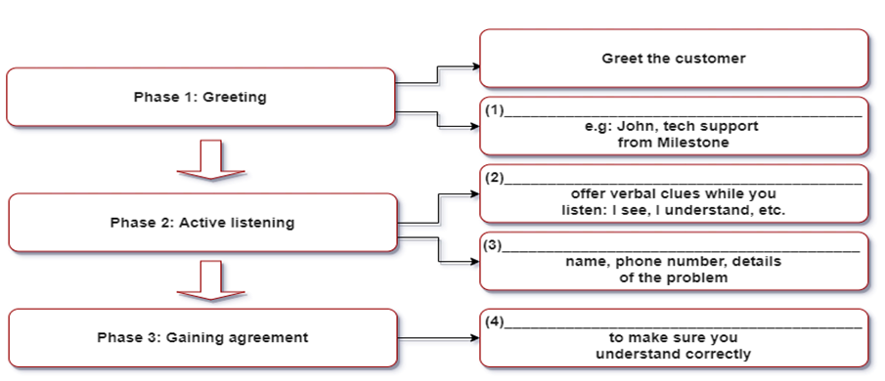
Identifying yourself
Listening to the customer’s complaint
Getting necessary information
Confirming the details

Slide 38
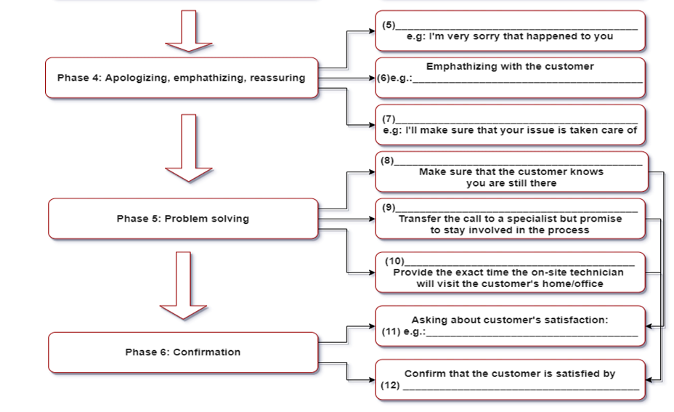
Apologizing to the customer
I’d be upset too if I were you
Assuring the customer
Handling the issue while the customer’s on hold
Escalating the ticket to level 2 support
Arranging on-site support
Are you satisfied with our solution?
sending a letter of resolution or
making a follow-up call

Slide 39
Activity 5: Role-play
- Work in pairs
- Make conversations based on given information in the tables

Slide 40
Situation 1: Handling an issue while a customer is on hold
A: Technician | B: Customer
Greet the customer and Identify yourself | Complain about a problem with website
Ask for B’s name and phone number | State your name and phone number
Ask for details of problem | Explain your problem: can’t log in
Ask for computer brand and OS | - Computer brand: Dell Vostro 3250, OS: Windows 8
Ask for browser and IP address | - Browser: Google Chrome. IP address: 168.235.1.1
- Summarize the details - Ask B if you have the correct information | Confirm the details
- Apologize, empathize, and reassure - Ask if B wants to wait or wants a callback | Say you’ll wait
- Say you are working on the issue - Ask B to try logging in again | Say you’ve logged in successfully Thank A
Offer additional help | Decline and say goodbye

Slide 41
Situation 1
T: Apex technical support. Tom speaking. How may I help you?
C: Oh, good. I’m afraid I have a complaint to make. I have a problem with your website.
T: First, let me just get your name and phone number in case we get disconnected.
C: My name is Melinda and my phone number is 555 232.
T: And what kind of problem do you have with our website?
C: I can’t log in to my account.
T: OK then. I need to know your computer brand and the OS you are using.
C: I have a Dell Vostro 2350 and I’m using Windows 8.
T: OK, can you tell me what kind of browser you are using and your IP address?
C: I’m using Google Chrome and my IP address is 168.235.1.1.

Slide 42
Situation 1 (continued)
T: Now let me repeat back to you to check if I got everything down correctly. You can’t log in to your account on your Dell Vostro 2350 computer with Windows 8. You are using Google Chrome and your IP address is 168.235.1.1. Is that correct?
C: Yes, that’s right.
T: Let me start by saying that I’m sorry this happened to you. I’m sure I’d be upset too if I were you. I’m going to do all that I can to help you. Do you want to stay on the line while I’m fixing it or would you like me to call you back?
C: I’ll wait please.
T: OK I’m working on the issue. Now can you try logging in again?
C: Oh, I can log in now. Thank you very much.
T: I’m glad to be of help. Is there anything else I can help you with?
C: No, that’s all for now. Goodbye.
T: Goodbye. And please call again if you have further problems.

Slide 43
Situation 2: Handling an issue while a customer is on hold
A: Customer | B: Technician
Ask for technical support | Greet the customer and identify yourself
Ask for an update on a previously reported problem | Ask for ticket number
Ticket number: 823431 | Ask A to confirm the details - Name: Mark Grey, address: 23, Park Hill - Phone: Samsung 7 plus, OS: Android - Issue: unable to make airplane ticket booking
- Say the details are correct - Ask B about the progress of handling the issue | - Check connection to booking website - Check browser version ⇨ Find no issue
- Express anger (you called 6 hours ago) - Say you need to travel tomorrow | - Apologize, empathize and reassure ⇨ Promise: on-site technician will visit in next 2 hours
- Say you’ll wait | - Promise: you’ll stay involved - Offer additional help
Decline and end the conversation | Thank the customer and say goodbye

Slide 44
Situation 1
C: Hello, is this the number of the technical support department?
T: Yes, hello, this is John, your service agent from Apex. Can I help you?
C: I’d like an update on my problem with one of your applications.
T: Can you tell me your ticket number please?
C: Let me check: 823431
T: OK, let me read back to you your details first: you are Mr. Mark Grey, address: 23 Park Hill. You are using Samsung 7 plus with Android. And you were unable to make airplane ticket booking through our booking application. Is that correct?
C: Yes that’s right. I’d like to know what you have done so far about my issue.

Slide 45
Situation 1 (continued)
T: Well, we have checked your connection to the website and find no issue, your browser version is also current.
C: This is getting ridiculous. I called your company 6 hours ago. I will need to travel tomorrow. What are you going to do about this?
T: First, let me start by saying that I’m sorry this happened to you. I’m sure I’d be upset too if I were you. I’m going to do all that I can to help you. In fact, I already escalated your ticket to an on-site technician. He’s going to visit your house in the next 2 hours.
C: OK, I’ll wait
T: Please know that I’m going to personally monitor your issue and make sure that it’s taken care of. Is there anything else I can help you with?
C: No, thanks. Goodbye
T: Thank you for bringing this to our attention. Goodbye.

Slide 46

Activity 6: Dos and Don’ts of technical support
- Work in pairs
- Look at the following statements made by service agents
- Discuss which of the statements in the following situations is the best technical support practice and why

Slide 47
The technical support survey
1. Greeting the customer
a. Hello, technical support. This is John from Apex, can I help you?
b. Hello, tech support here.
c. Hello, this is Milestone, the leading IT support provider in US. Our goal is to provide you with the best customer service experience. I’m John Bolton, your service agent. How can I provide you with excellent service today?
2. Refusing a customer’s request:
a. I’m sorry but I’m going to have to say no to that.
b. As much as I’d like to help, I’m afraid that’s not possible. However, we can arrange for a technician to help you properly configure it.
c. I’m sorry for what happened to you but according to our policy, we can’t do that. You can refer to our customer service handbook for more information.
√
√

Slide 48
The technical support survey
3. Dealing with an upset customer:
a. I’m sorry that you have had to go through that.
b. I’m sorry but I fail to see how this is our fault.
c. I’m afraid I don’t have time to deal with that right now.
4. Handling a customer’s question that you can’t answer
a. I’m sorry I have only worked here for 2 weeks.
b. If I recall correctly our software is compatible with iOS.
c. Let me check our database and answer that for you later.
√
√

Slide 49
The technical support survey
5. Responding to a customer’s criticism of the company’s product on an online forum
a. I’m sorry but why would you think that?
b. May I ask why you feel that way?
c. Your opinion doesn’t really matter because we have thousands of satisfied customers.
6. Responding to a bug that a customer found in your product and reported to you
a. Thank you but our team has already identified the bug and is working on it.
b. No response is required.
c. Thank you for bringing this to our attention, we appreciate it.
√
√

Slide 50
The technical support survey
7. Responding to a request to a new feature that is unreasonable
a. I’m sorry but we are not going to do that.
b. I understand why you’d want that but it is just unfeasible for now.
c. I’m afraid the feature that you requested is unreasonable.
8. Taking over someone from your team in a live chat thread
a. Can you summarize the main points of the conversation so far?
b. I’ve read through the conversation so far.
c. Can you explain your problem again for me please?
√
√

Slide 52
Follow-up activity
Should
Shouldn’t
Use a friendly, authentic greeting
Use either a curt or lengthy “canned” greeting
Use policy as an excuse to refuse the customer’s request
Offer alternative solutions to a customer’s request
Thank the customer for reporting a problem to you
Interrupt the customer to explain a problem
Admit that you don’t know the answer and focus on
what you will do to find out.
Guess the answer to a question you don’t know
Ask the customer politely for the root cause of the criticism
Say that you are new in the job therefore
don’t know the answer
Read the previous messages in a live chat thread
Respond angrily to a customer’s criticism

Slide 53
active listening, escalate, authentic, letter of resolution, empathizing, assure, on-site technician, problem solving
All support personnel must adhere to the following procedure for handling a customer’s complaint. The first step is greeting the customer and identifying yourself. A good greeting should be concise but has to contain the following information: your name, position, company name. More importantly, be (1)_____, professional and friendly.
The second step is (2)_____. Offer verbal clues such as: “I see” or “I understand” and take notes if necessary. In addition, you need to ask for customer’s personal details and specifics of the issue to ensure you can provide the correct solution.
The third step is gaining agreement. You need to summarize the issue the customer has been experiencing and any necessary details and confirm that you have the correct information.
The fourth step is apologizing, (3)_____ and assuring. Offer an apology only if the problem is caused by the company or one of our products. In any case, an expression of empathy is always welcomed, for example: “If I were you, I would be upset too”. Finally, (4)_____ the customer that we will take ownership of the problem and will do anything necessary to help them.
The next step is (5)____. Ask the customer if he/she prefers to wait while you are working on the issue or want you to contact him/her later. If the customer decides to wait, handle the customer’s problem quickly. If the customer wants you to call back later, end the conversation with a friendly tone and work on the issue. If you have to (6)____ the customer’s ticket, provide the exact time the (7)____ will visit the customer’s home or office. The final step is confirmation. In this step you need to ensure that the issue has been addressed to customer’s satisfaction. Send a (8)____ or make a follow-up call after the incident has been completely resolved.
authentic
active listening
empathizing
assure
problem solving
escalate
on-site technician
letter of resolution

Slide 54
Activity 7: Complaint handling procedure
- Work individually
- Prepare a free talk about the procedure for handling a customer’s complaint based on the suggestions:
Greeting
Active listening
Gaining agreement
Apologizing, empathizing and assuring
Problem solving
Confirmation

Slide 55


Customer service quote
In the world of internet customer service, it’s important to remember your competitor is only one mouse click away
- Doug Warner

Slide 56
Thank you for your attention
And good luck

